Slide 1
Lionbase Technical Case Study
Comparing Citi Bike usage with Uber ride data
Joheen Chakraborty (jc5110)
github.com/joheenc/Lionbase-Case-Study
Please use Presentation Mode to go through the slide deck!

Slide 2
Data used, Assumptions made, & End goal
Data:
Citi Bike NYC open data, April-Sept 2014
Start location (lat, lon) and time (month, day, hour, minute) for 5,359,995 Citi Bike trips
https://www.citibikenyc.com/system-data
Uber NYC open data, April-Sept 2014
Start location (lat, lon) and time (month, day, hour, minute) for 3,092,682 Uber trips
https://www.developer.uber.com
Assumptions:
There may be some correlation between Uber & Citi Bike trip patterns (strongly justified later)
There may be some time-series trends within Uber data & Citi Bike data
Pretend we’re in 2014
Goal (business-oriented):
Use correlation between Citi Bike & Uber trip data to find optimal locations for new Citi Bike stations

Slide 3
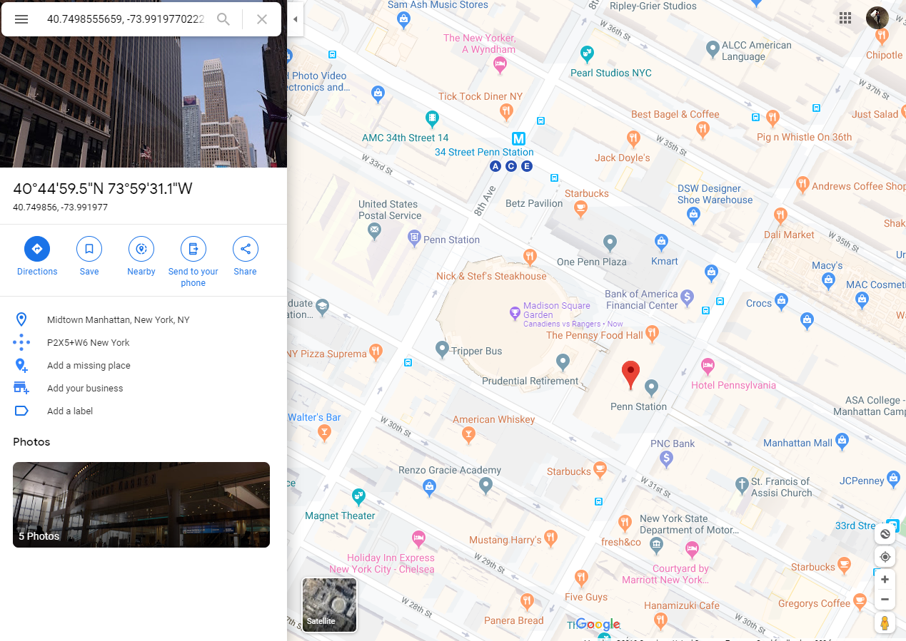
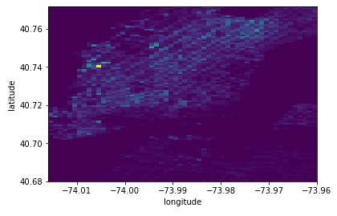
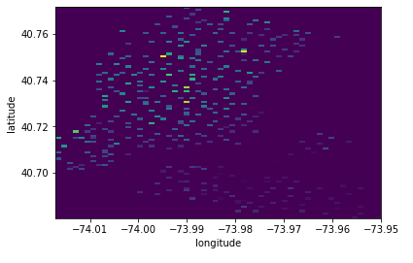
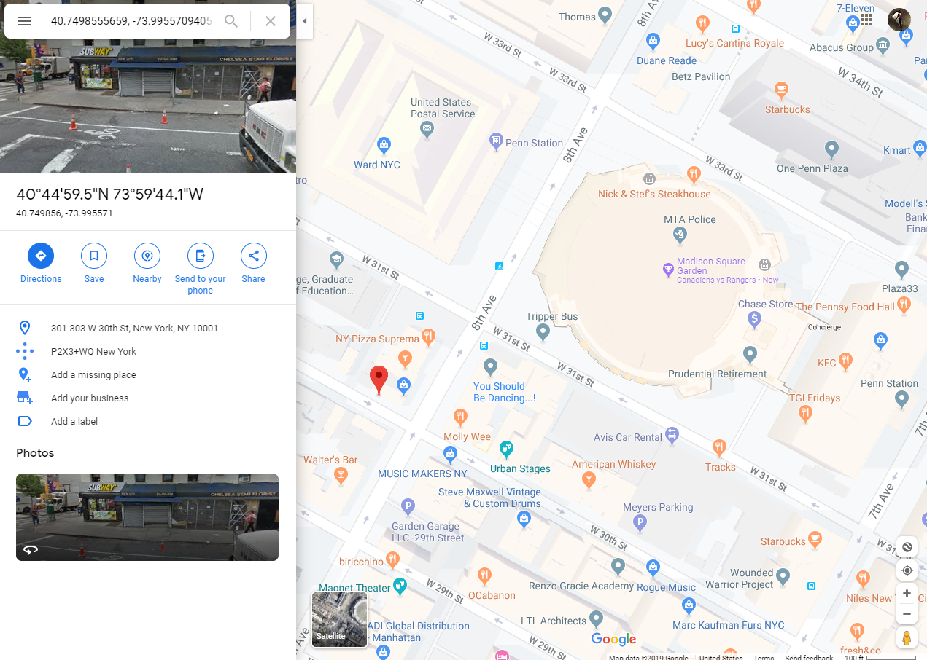
Divided NYC into 100m x 100m bins to create 2D Histograms of...
Uber ride requests (start locations), n=3,092,682
Citi Bike trip stations (start locations), n=5,359,995
-continuous distribution (can call an Uber from anywhere)
-discrete bins (have to start from a Citi station)
Both Uber & Citi data show the most common start location for trips is right outside Penn Station (which makes sense--that’s good!)

Slide 4
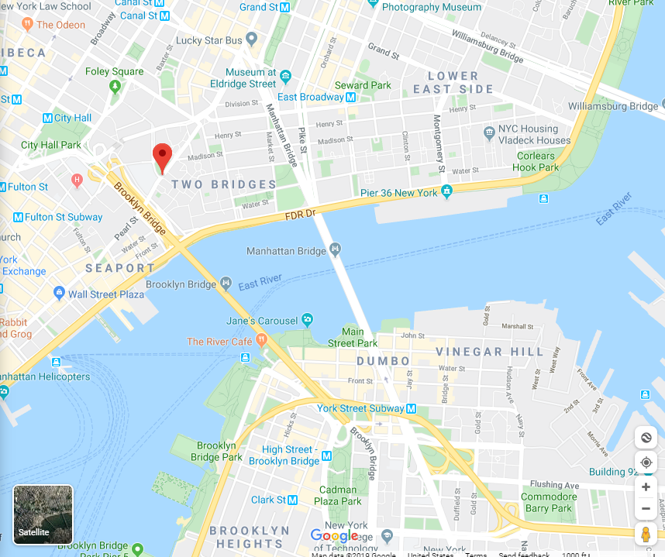
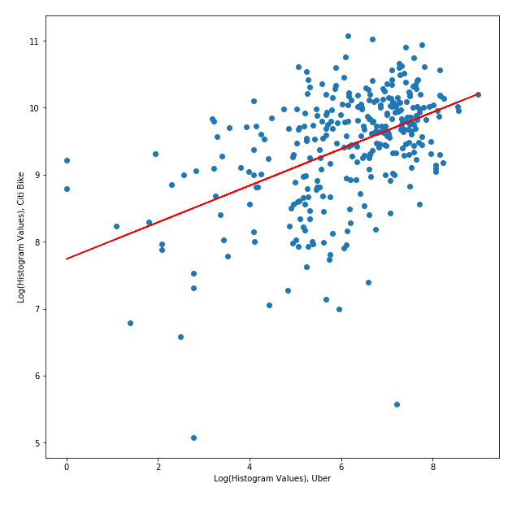
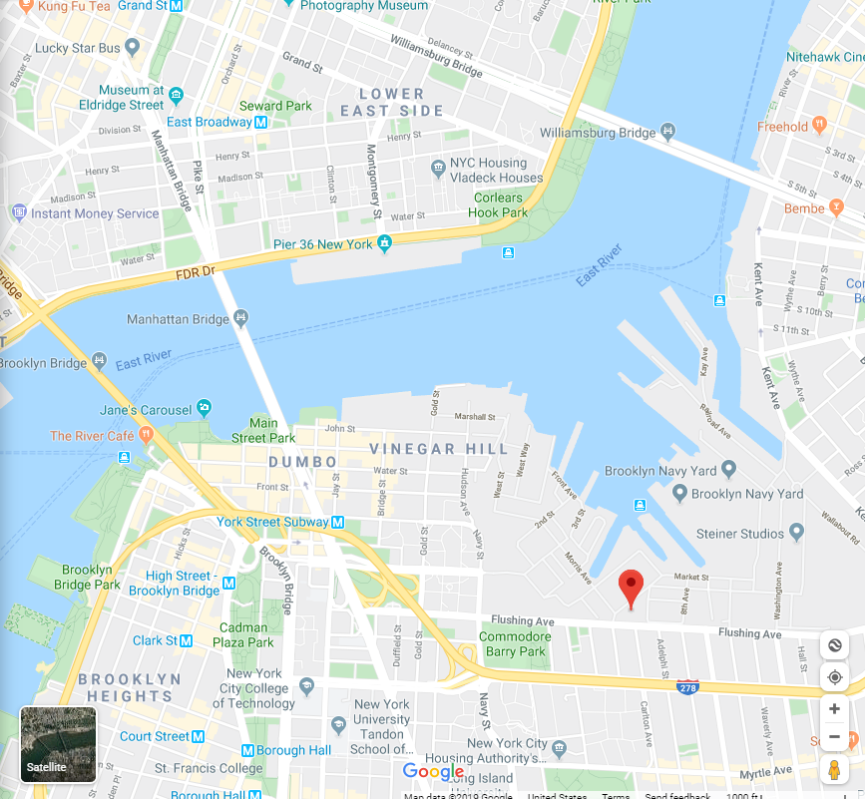
Histogram values for Uber vs. Citi
Both directly outside Penn Station (as we saw before)
People use Citi Bike
significantly more than
Uber
(Parks are overrepresented)
True NYC
(Lots of Manhattan)
Neither is popular because…
-Subway?
-Walking attraction?
-No man’s land?
(Brooklyn is overrepresented)
Right next to the
Brooklyn Bridge
People use Uber significantly
more than Citi Bike
(Downtown is
overrepresented, esp.
NYU & New School areas)
Strong positive correlation -- this is VERY useful, as it allows us to make predictions given only one piece of info!

Slide 5
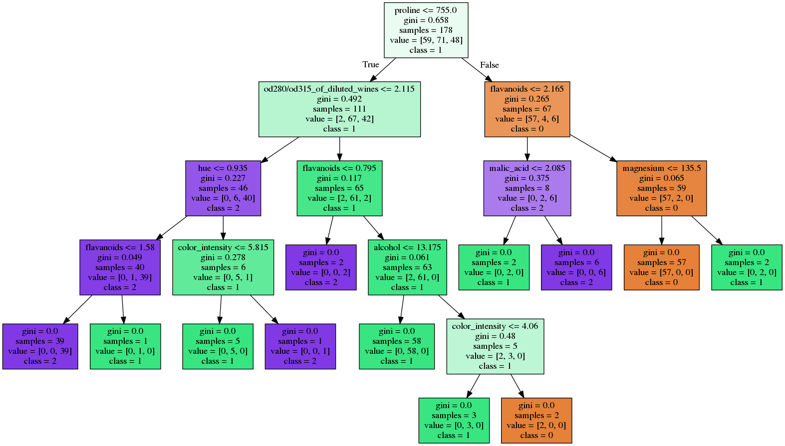
We can do better - Decision Trees & Random Forests
-Decision Tree: like a (complicated) piecewise function
-perfect for multivariate analysis
-now the independent variables are Latitude,
Longitude, and Uber request frequency
-Random Forest: just a collection
of decision trees that “vote” on the
best answer
-Classification vs. Regression;
we want regression

Slide 6
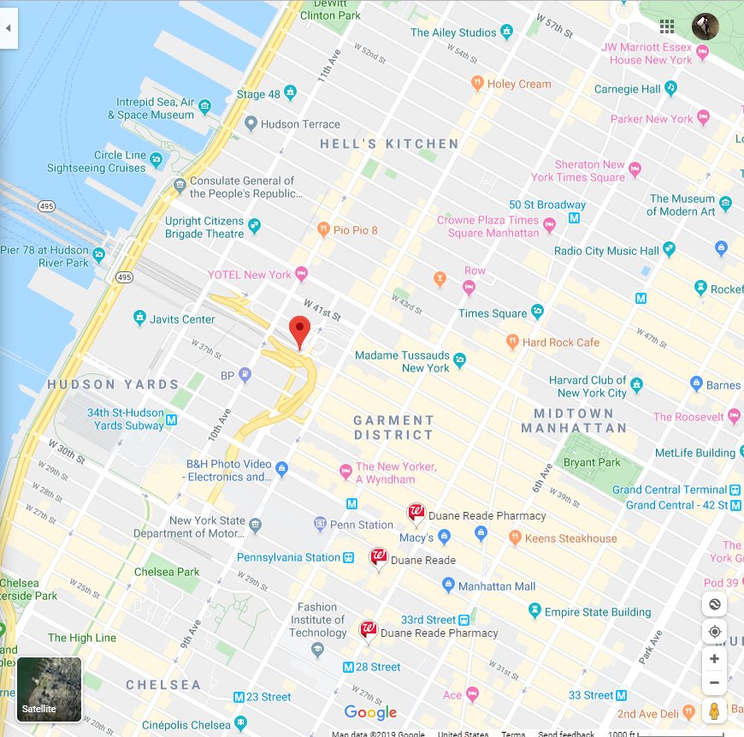
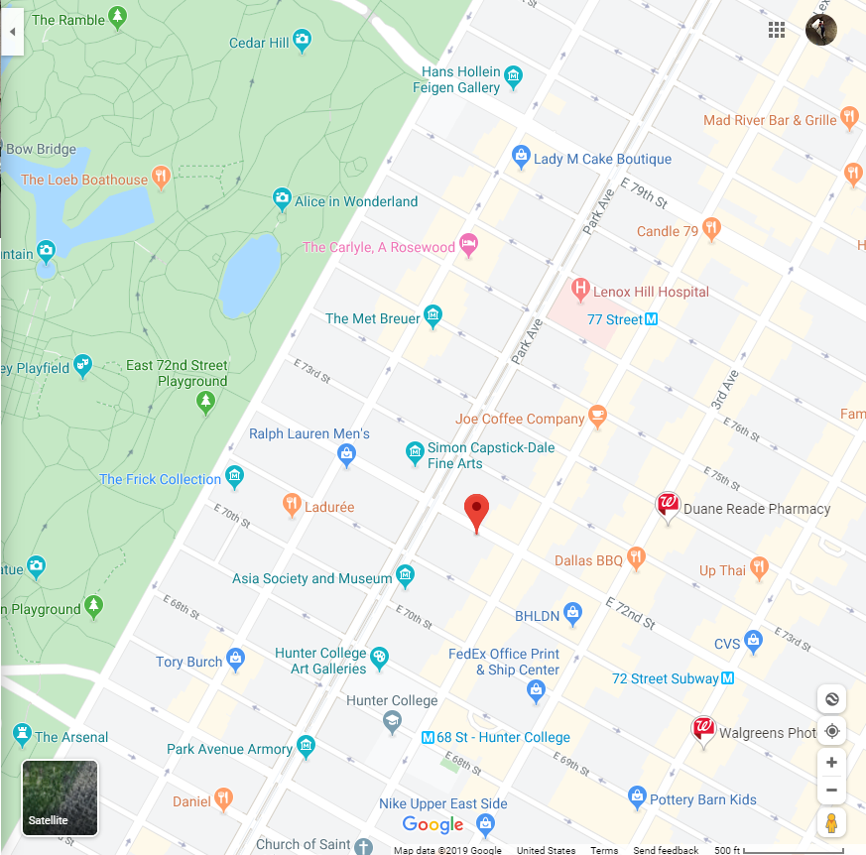
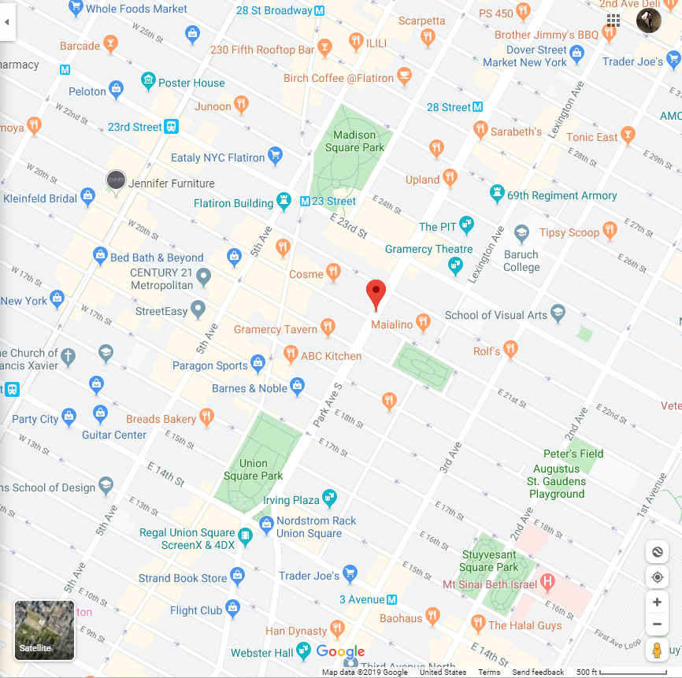
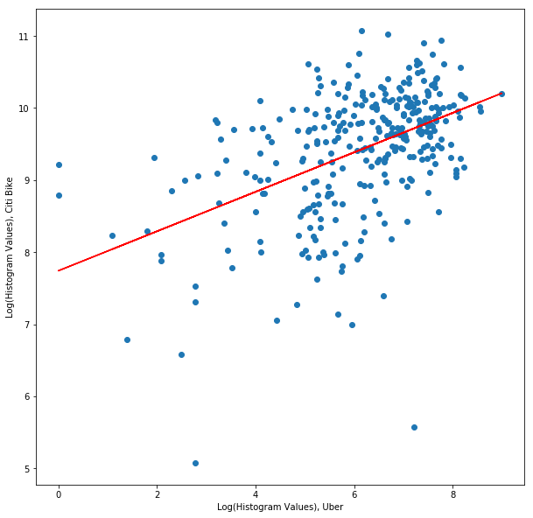
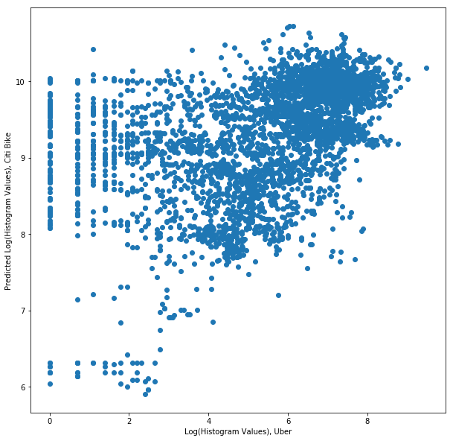
Predicted optimal locations:
Looks pretty reasonable! We’re interested in these points:
-Seems parks are a common theme
-Strangely enough, so are colleges. But we saw the opposite earlier...
The suspicious predictions in this region can be explained by the scarcity of points there in our original graph

Slide 7
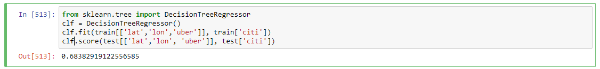
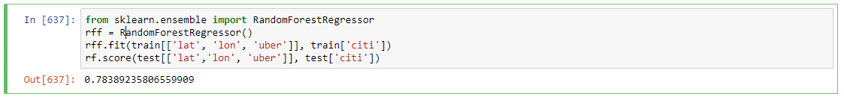
Model performance
R^2 score for the Decision Tree model = 68.3%
R^2 score for the Random Forest model = 78.4%
But we can still do better...

Slide 8
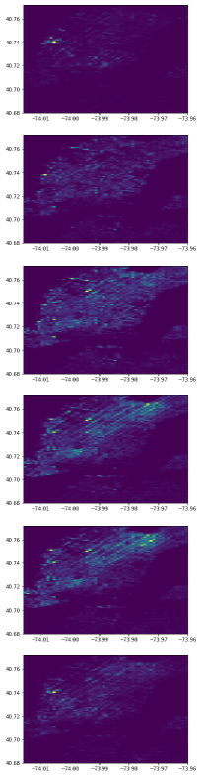
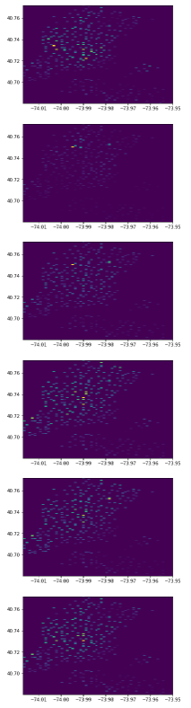
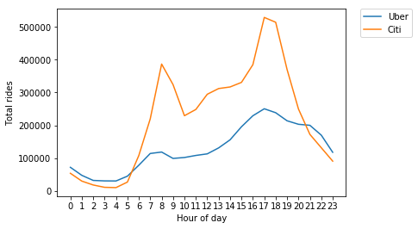
Considering data in a time series
Uber Timesteps
Citi Timesteps
-Because there is data from April to September, there are enough repetitions to consider patterns over the course of a day (but not really weeks, certainly not months or years)
-Uber and Citi data do not have the same time evolutions, so maybe model accuracy can be improved by examining time of day

Slide 9
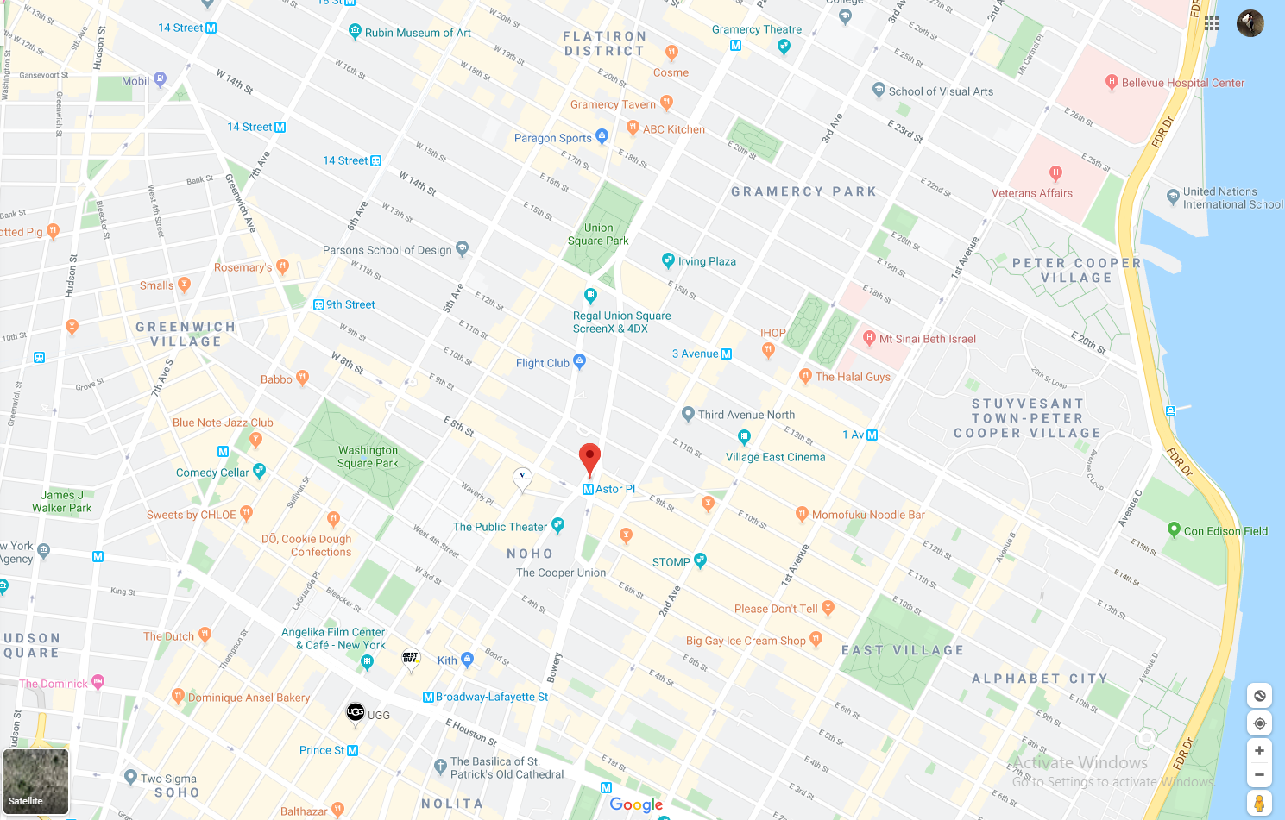
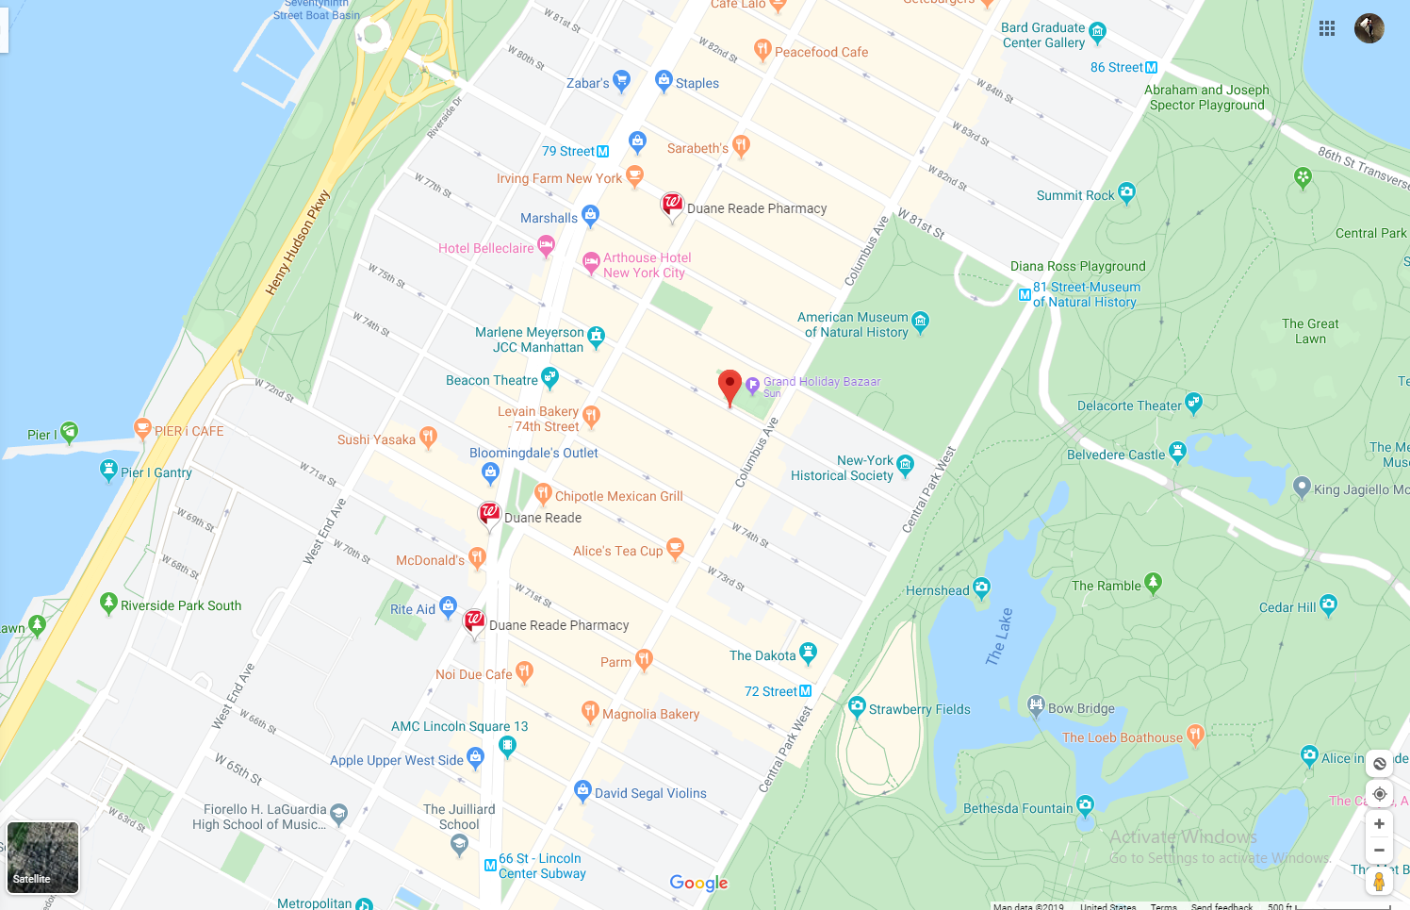
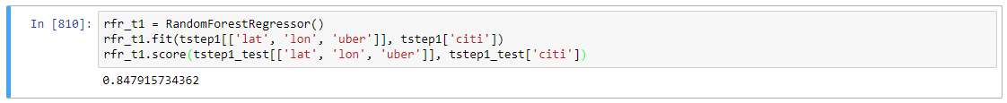
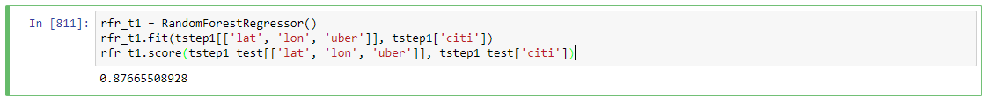
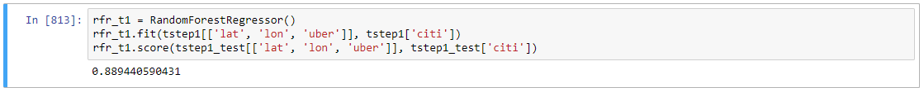
Improved model performance & new predictions
e.g. from 18:00-23:59 Citi Bikes are more popular downtown (left), but from 0:00-5:59 they’re more popular uptown (right)

Slide 10
Next steps/ideas
-With more time-series data, model can be used to determine when certain Citi Bike stations should be restocked
-a Recurrent Neural Network would be particularly good for this (but would need many more points
-Hyper-parameter optimization to increase model performance
-More independent variables (though you’d have to get creative with quantifying)
Thanks for listening!

